Slide 1
Melanoma Cancer Progression Model: using Capri
Jessie Bologna
NYU – Bioinformatics
Dec 2020

Slide 2
Overview :
Summary of Cancer Evolution
Why it is important
Overview of cancer progression models
Melanoma progression model using CAPRI
Notes:
Here is just a quick overview of what I will be discussing -

Slide 3
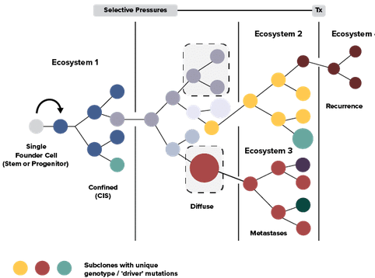
Cancer Evolution:
Goal: To identify specific mutations or mutational patterns that drive cancer progression
Cancer development and progression closely follows a traditional clonal Darwinian evolution
Most Cancers progress through the accumulation of alterations that affect gene functions
This is typically driven by step-wise somatic mutations with sequential sub-clonal selections (Nowell, 1976)
Driver mutations give cells the selective advantages that lead to further tumor progression
Image: Greaves & Maley, 2012. Clonal evolution in cancer. Nature

Slide 4
Cancer Evolution: Alterations
Passenger Mutations: Neutral mutations, little to no effect
Driver Mutations: Leads to tumor cell proliferation and disease progression
Activation/deactivation of proteins
Deregulation of cellular processes
Leading to intra-tumor heterogeneity

Slide 5
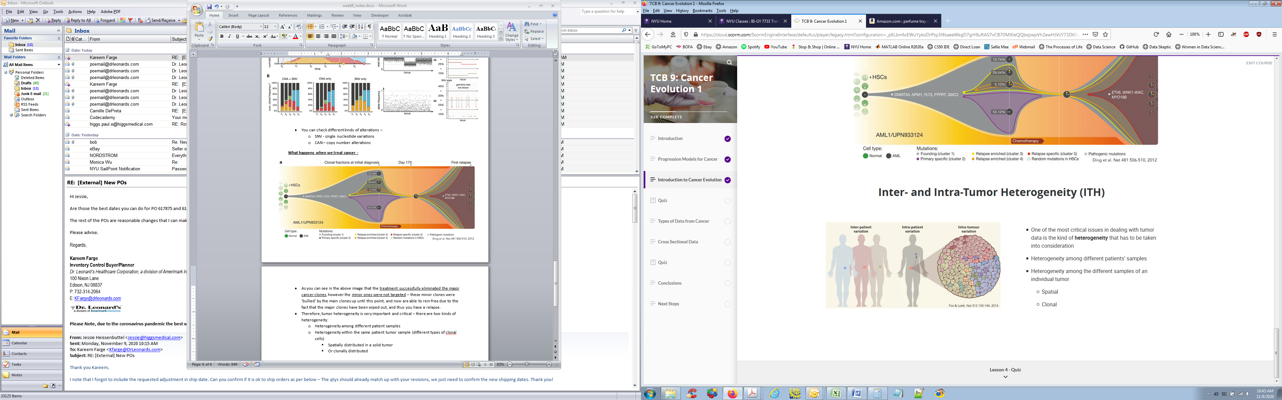
Cancer Evolution: Intra-Tumor Heterogeneity
Intra-tumor heterogeneity plays an important role in how cancer develops and evolves
As time passes clones and sub-clones within a tumor continue to grow and mutate causing a variation of different cells within a tumor
Intra-tumor heterogeneity is seen in -
Cellular morphology
Genetic variation
Gene expression
Knowing the heterogeneity of a tumor can serve as a clinically valid molecular marker (Gerashchenko, et al., 2013)

Slide 6
Cancer Evolution: Why it’s important
Knowing the evolution and progression of cancer is critical in drug development and treatment decisions:
Patients at different stages and with different mutational evolutions will respond differently to various treatments
Treatments that target dominant tumor clones will cause a shift in selective pressures, allowing certain minor sub-clones to multiply which can result in disease relapse.

Slide 7
Cancer Evolution: Progression Models
Predicting the path of cancer progression can be critical in diagnostic, prognostic, and treatment options.
There are many progression models available that use a variety of methods; including – Conjunctive Bayesian networks, DAGS, Phylogenetic tree models, etc.
Goals:
Identifying driver alterations and inferring progression
Determine the mutational landscape of the tumor genome
Determine differences at various phases of disease, i.e. recurrence/ metastasis
Evaluate impact of therapies/ treatments
Examples –
CAPRI (Cancer Progression Inference) – DAG producing model – Ensemble data
CAPRESE (Cancer Progression Extraction w/ Single Edges) – Bulk data - Tree producing model
TRAIT (Temporal Order of Individual Tumors) – Bulk data - Tree producing model
LACE (Longitudinal Analysis of Cancer Evolution) – Single cell - tree producing model
Notes:
Now I will move on to briefly review cancer progression models..

Slide 8
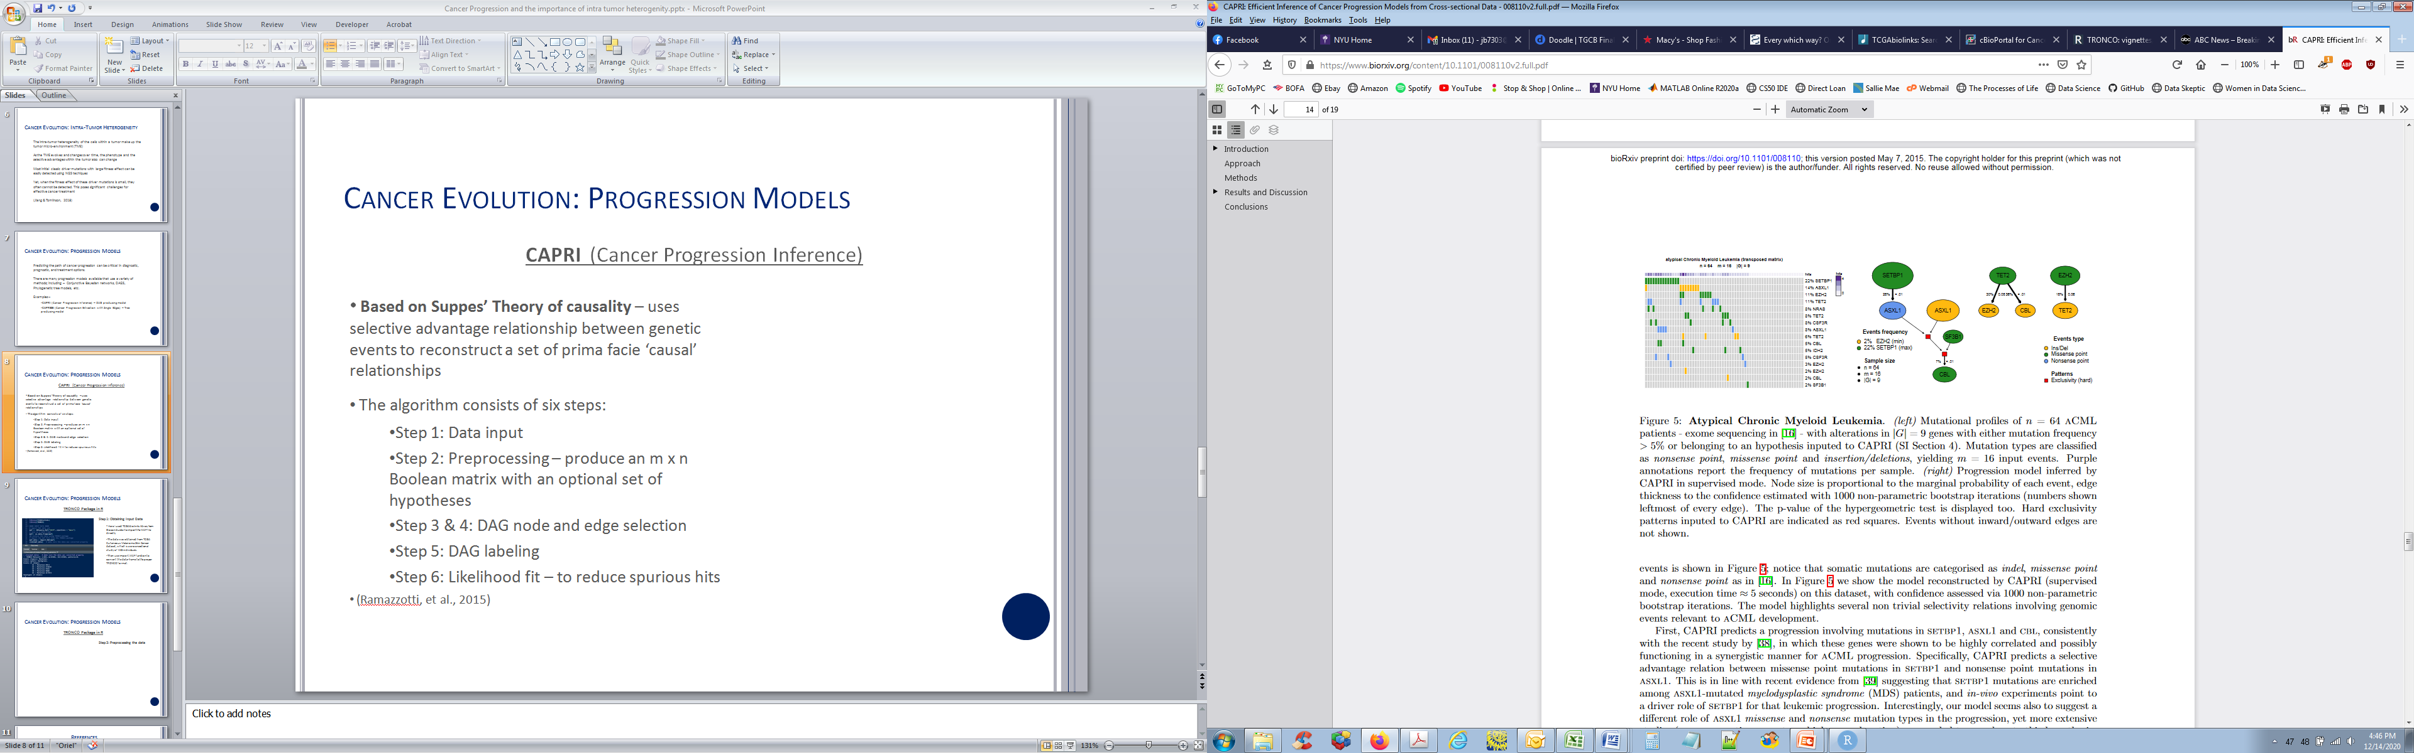
Cancer Evolution: CAPRI (Cancer Progression Inference)
Based on Suppes’ Theory of causality – uses selective advantage relationship between genetic events to reconstruct a set of prima facie ‘causal’ relationships
The CAPRI algorithm:
Step 1: Data input (MAF or Gistic file)
Step 2: Preprocessing – produce an m x n Boolean matrix with an optional set of hypotheses
Step 3 & 4: DAG node and edge selection
Step 5: DAG labeling
Step 6: Likelihood fit – to reduce spurious hits
(Ramazzotti, et al., 2015)
Notes:
I used the CAPRI model to run a progression inference on cross sectional melanoma data that I obtained from TCGA
Before I get into my model, I wanted to just quickly review the CAPRI model..
Step 1: Data input (this is a MAF or Gistic file)
Step 2: Preprocessing – you want to further refine your data based on certain hypothesis or a curated list of events etc. Also your data needs to be an m x n Boolean matrix – which the TRONCO package has a built in function which formats your file for you
Step 3 4, 5 – constructs your graph based on the causal relationships of the events in your data
Step 6: uses maximume likelihood fit with bootstrapping – to reduce errors and spurious hits to further refine your output

Slide 9
Cancer Evolution: Melanoma
Why investigate Progression of Melanoma -
Melanoma incidences are increasing - with about 100,350 new cases estimated to be diagnosed in 2020 (American Cancer Society)
While there have been many recent discoveries, events that drive tumor progression in melanoma are still largely unknown.
Melanoma often has a low sensitivity to chemotherapy with many patients unable to achieve remission

Slide 10
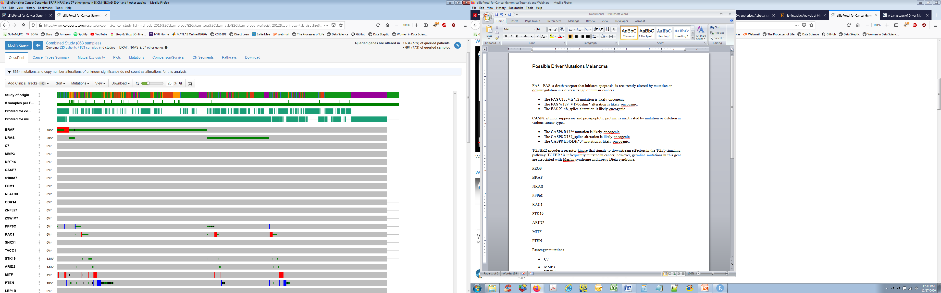
Cancer Evolution: CAPRI Melanoma Data
Input Data - Clinical cutaneous melanoma cross-sectional patient data from TCGA. Obtained directly from the Genomic Data Commons portal (https://portal.gdc.cancer.gov/)
http://www.cbioportal.org
Notes:
The data I used was the Clinical cutaneous melanoma cross-sectional patient data from TCGA.. And I obtained it directly from the Genomic Data Commons portal.
I then analyzed it using cbioportal and I selected only driver mutations by excluding mutations of unknown significance
I also excluded mutations that occurred in less than 5% of the samples

Slide 11
Cancer Evolution: CAPRI Melanoma Data
Event Selection: Literature review and Cbioportal analysis -
Most models show that founder BRAF or NRAS mutations are often first detected in precursor lesions that give rise to melanoma by accumulation of additional mutations(Shain et al., 2015).
Mutations noted in literature review and from cbioportal: BRAF', 'NRAS', 'PPP6C', 'RAC1', 'PTEN', 'GRIN2A', 'KMT2C', 'TP53', 'TP63', 'NF1', 'KDR', 'CDKN2A', 'AGO2', 'KMT2A', 'MUC16', 'MUC15', 'RASA2', 'RAC1', 'ARID2', 'TERT', 'PI3K', 'KIT', 'MET', 'MAP2K1‘
Notes:
Next I did a literature review to identify already known drivers –
for example I learned that Most models show that founder BRAF or NRAS mutations are often first detected in precursor lesions that give rise to melanoma by accumulation of additional mutations
So based on the literature review and the cbioportal analysis of my data I compiled a short list of potential melanoma drivers that I would be using as the events in my model

Slide 12
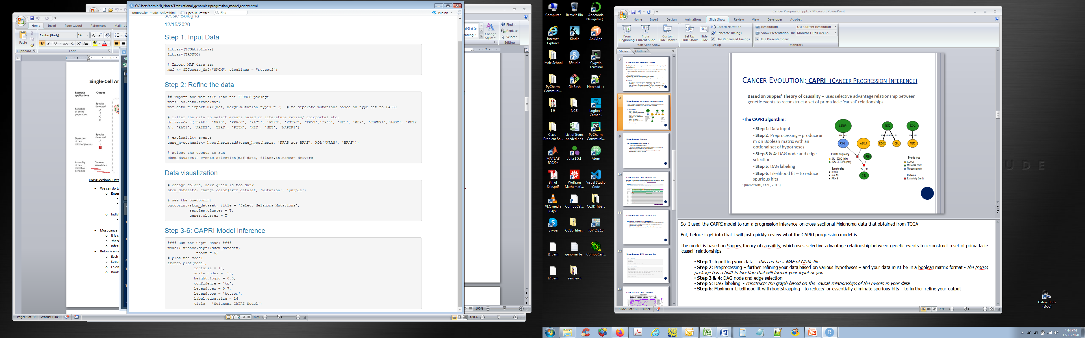
Cancer Evolution: CAPRI Melanoma Data
Notes:
Here is the R code for steps 1 and 2
I first installed the TCGAbiolinks and TRONCO libraries which are both part of the bioconductor package
Next I imported the MAF file using the TCGAbiolinks function which directly imports it from genomic data commons portal
Then I imported that file into the required tronco package binary matrix format by using the tronco function import.maf
I then filtered the data by using the list of drivers that I had compiled to select for the event that I would be using in the model

Slide 13
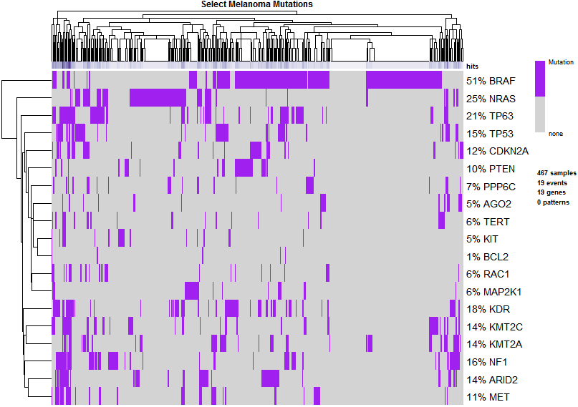
Cancer Evolution: CAPRI - Oncoprint
Notes:
Next I printed the oncoprint to get a visualzation of my data

Slide 14
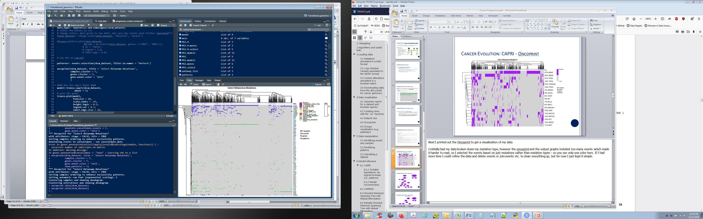
Cancer Evolution: CAPRI - Oncoprint
Notes:
I included this to show more detail – here the oncoprint show the data broken down by mutation type – which is too hard to read ..

Slide 15
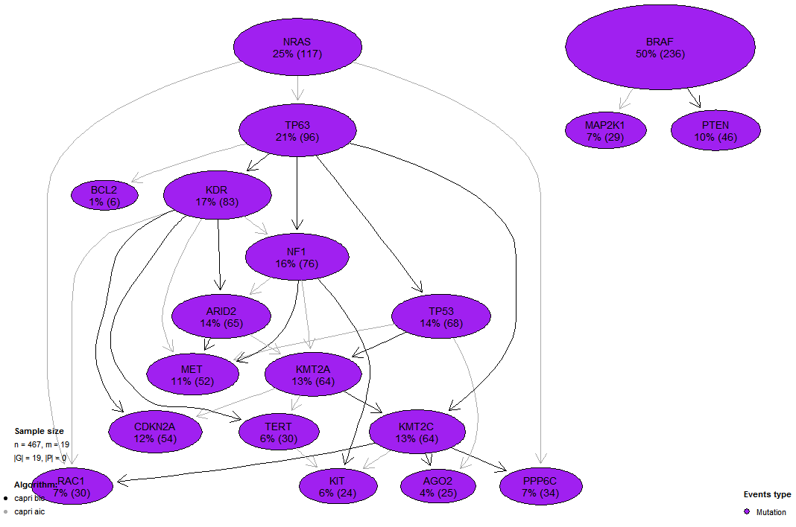
Cancer Evolution: CAPRI Model output
Notes:
Here is the output of my model..
The model clearly shows NRAS and BRAF as being mutually exclusive which is consistent with the literature – and also the data – and you can see how both NRAS and BRAF are the initiating mutations.
I also noted from the literature that NRAS mutations in Melanoma (as opposed to BRAF) often led to a higher mutation load, and a worse prognosis. (RAS targeting treatments, MEK inhibitors etc. – however NRAS targeted drugs have little success) – NRAS mutations occur in 15-25% of all melanomas despite sun exposure (BRAF is more common in sun exposed individuals)
So from the output we can infer the progression of these mutations; ie this mutation leads to this mutation which leads to this mutation, etc. Basically each node represents a driver mutation which leads to or points to additional mutations
BRAF Treatments - combination treatment with BRAF inhibitors and MEK inhibitors with – effective however, vast majority have relapse due to acquired resistance, Immunotherapy
NRAS treatments – Immunotherapy
TERT promotor mutations occurred in 71% of sample (higher than BRAF and NRAS!) and found in both patients with BRAF and with NRAS- Society for Huang, F. Translational Onconoly, Jan 2019

Slide 16
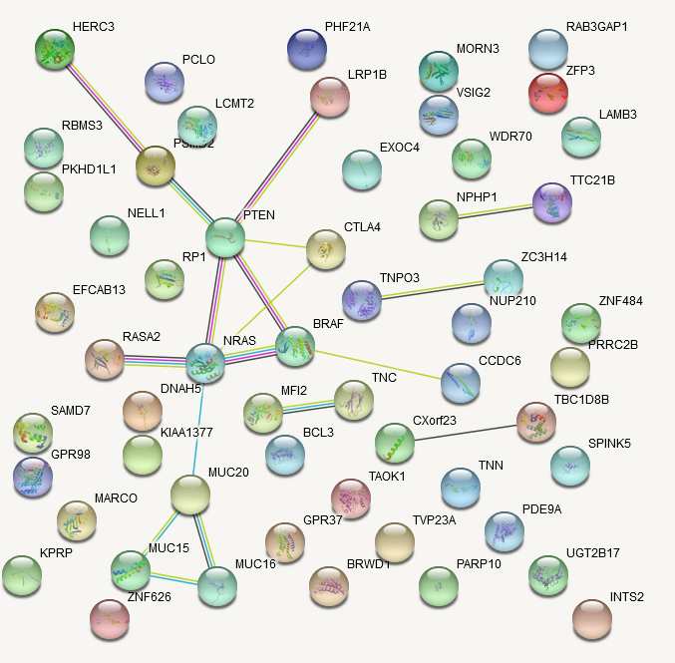
Cancer Evolution: Melanoma Progression additional insights
Below is a network from the String database with the top 50 occurring mutations for Melanoma -
From the network we can gain additional insights into why the NRAS pathway has a worse long-term survival rate -
MUC16 mutation is associated with tumor mutation burden and its prognostic implications in cutaneous melanoma (Wang, et al., 2020).
MUC20 and MUC15 are also part of a local network cluster causing familial hyperphosphatemic tumoral calcinosis (CL:26957).
Anti- CTLA4 has been used as a successful therapy to increase survival in Melanoma (Steinberg, 2020).
RASA2 is included in a local network of oncogenic MAPK signaling.
MUC20 is also noted in the reactome pathway as activated MET receptor recruits the RAS signaling.

Slide 17
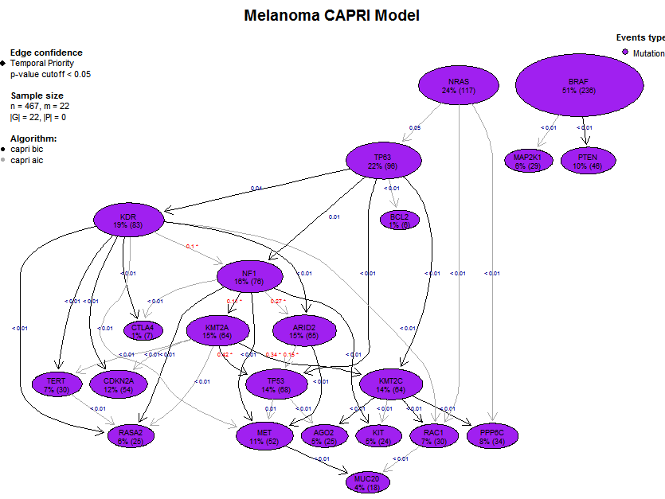
Cancer Evolution: CAPRI Model output additional insights
Notes:
Here is the output of the refined model using the additional insights based on the previous graph and the additional possible drivers

Slide 18
Cancer Evolution: Final Thoughts & Considerations
More data curation is needed-
Investigate pathway relations
Patterns, exclusivity etc.
Different hypotheses
Overall the CAPRI model showed a good progression inference
Can provide important information needed to create/ refine targeted treatment options
Notes:
So I kept my model pretty simple, there is probably a lot more information that can be infered from the data –
if I were to do a full analysis I would want to curate my data more by..

Slide 19
Notes:
Here is my R code for the model.. This is pretty much everything, so it was fairly simple and the TRONCO package was pretty user friendly

Slide 20
References
Birkeland, E., Zhang, S., Poduval, D., Geisler, J., Nakken, S., Vodak, D., Meza-Zepeda, L. A., Hovig, E., Myklebost, O., Knappskog, S., & Lønning, P. E. (2018). Patterns of genomic evolution in advanced melanoma. Nature communications, 9(1), 2665. https://doi.org/10.1038/s41467-018-05063-1
Davidson, G., Coassolo, S., Kieny, A., Ennen, M., Pencreach, E., Malouf, G. G., Lipsker, D., Davidson, I. (Jan 2019). Dynamic Evolution of Clonal Composition and Neoantigen Landscape in Recurrent Metastatic Melanoma with a Rare Combination of Driver Mutations. Journal of Investigative Dermatology, Vol 139, Issue 8, 1769-1778.e2,ISSN 0022- 202. Retrieved from https://doi.org/10.1016/j.jid.2019.01.027
Gerashchenko TS, Denisov EV, Litviakov NV, Zavyalova MV, Vtorushin SV, Tsyganov MM, et al. (2013). Intratumor heterogeneity: nature and biological significance. Biochemistry (Mosc); 78:1201–1215. doi: 10.1134/s0006297913110011.
Greaves, M., & Maley, C. C. (2012). Clonal evolution in cancer. Nature, 481(7381), 306–313. https://doi- org.proxy.library.nyu.edu/10.1038/nature10762
Hodis, E., Watson, I.R., Kryukov., G.V., et al. (July 2012) A Landscape of Driver Mutations in Melanoma. Cell, Vol. 150, Issue 2, 251-263, ISSN 0092-8674, doi: 10.1016/j.cell.2012.06.024. Retrieved from https://www.sciencedirect.com/science/article/pii/S0092867412007787
Jiang, X. & Tomlinson, I.P.M. (July 25, 2018). Cancer evolution in a changing microenvironment. bioRxiv 377226; doi: https://doi.org/10.1101/377226 Now published in Open Biology doi: 10.1098/rsob.190297
Nowell, P. C. (1976) The clonal evolution of tumor cell populations. Science 194, 23–28. The foundation paper that established the evolutionary theory of cancer.
Ramazzotti, D., Caravagna, G., Loohuis, L.O., Graudenzi, A., Korsunsky, I., Mauri, G., Antoniotti, M., Mishra, B. (Sept 2015) CAPRI: efficient inference of cancer progression models from cross- sectional data, Bioinformatics, Volume 31, Issue 18, 15, Pages 3016–3026, https://doi.org/10.1093/bioinformatics/btv296
Shain, A.H., Yeh, I., Kovalyshyn, I., Sriharan, A., Talevich, E., Gagnon, A. et al. (2015) The genetic evolution of melanoma from precursor lesions. N Engl J Med. 2015; 373: 1926-1936. DOI: 10.1056/NEJMoa1502583
Wang, X., Yu, X., Krauthammer, M., Hugo, W., Duan, C., Kanetsky, P.A., .. Et al. (Sept 1 2020). The Association of MUC16 Mutation with Tumor Mutation Burden and Its Prognostic Implications in Cutaneous Melanoma Cancer Epidemiol Biomarkers Prev (29) (9) 1792-1799; DOI: 10.1158/1055-9965.EPI-20-0307
Wang Q, Yang Y, Yang M, Li X, Chen K. (June 2020) High mutation load, immune-activated microenvironment, favorable outcome, and better immunotherapeutic efficacy in melanoma patients harboring MUC16/CA125 mutations. Aging (Albany NY). 2020 Jun 3;12(11):10827-10843. doi: 10.18632/aging.103296. Epub 2020 Jun 3. PMID: 32491995; PMCID: PMC7346065.

